Slide 1
WELCOME
Uplifting Our Power with Action Learning
ECMC Foundation CTE Leadership Collaborative Convening
Tuesday, September 19th, 2023 3:20 - 4:40 pm
Notes:
Link to the ECMC Fellowships here
3:20-3:35 Energizer & Action Learning Overview (slides 1-9)

Slide 2
Agenda
Welcome and Agenda Overview
Starbursts
Action Learning Method Overview
Reflection: My Challenge
Practice: Action Learning #1
Practice: Action Learning #2
Reflections & Closing

Slide 3
Outcomes
Our desired outcomes are that we will have….
Learned & applied Action Learning Coaching method
Increased awareness and appreciation for the use of powerful questions
Commitment to action related to a challenge or priority
Practitioner &
Organizational
Development
Network Data
Sharing

Slide 4
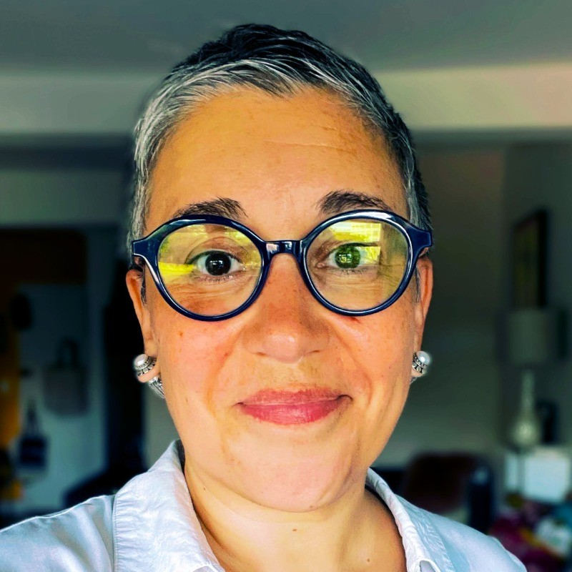
Facilitator
Sherazade Langlade (she/her)
CEO, Workforce Professionals Training Institute

Slide 5
STARBURSTS
At your table, introduce yourself by sharing your name, pronoun, organization and role….and based on your starburst color the question below.
Pink: I am most energized when …..
Yellow: I approach a challenge by ……
Red: When I feel stuck, I usually …….
Orange: People tend to count on me for….

Slide 6
Our Agreements
Commit to community
Lean into discomfort
Honor the process
Offer grace, gratitude and celebration

Slide 7
Action Learning
Through Action Learning we will:
Focus first on the right questions rather than the "right answers”.
Clarify the exact nature of the problem, and explore what is known and unknown.
Practice probing and powerful questions that enrich the learning experience.
Ask questions that help the problem owner develop solutions rather than gathering information to solve it for them.
Action Learning is successful when:
Problem is clarified
Peer exchange is happening
Solution is action-based
Each presenting individual makes a commitment of action

Slide 8
Asking Powerful Questions
More Powerful
What
Open
Concise
Expansive
Learning
Curious
How
Who, When, Where
Less Powerful
Have you, Did you, Do you
Judging
Leading
Wordy
Closed
Why didn’t you, Why would you

Slide 9
Sample Powerful Questions
Gather Information: Where are you stuck?
Increase Awareness: What are you feeling?
Expand Thinking: What would the ideal outcome be? Look like?
Promote Action: What are you willing to change?
Focus on Learning: If you could do it over, what would you do?

Slide 10
Challenges to Bring to Action Learning
Good action learning challenges:
Have meaning/significance to you
Address a challenge or issue(s) related to style, practices, relationship(s), opportunities and hopes
Are in your sphere of authority or influence to address
Need help and support from others to successfully address
Can be addressed (fully or partially) in the near term
Notes:
after explaining this slide, PAUSE and give each person ~4 minutes to reflect on a challenge and write it down
for soothing music, click on the youtube video embedded in the slide, make sure audio is on
video is set for 4 minutes
3:36-3:41 Independent self reflection (music to be played / participants complete a worksheet)

Slide 11
Action Learning
Roles & Flow
Opening
Reach under your chair, if there is a YELLOW post it note under your chair, you will be problem presenter.
Room Facilitator will lead all groups in grounding
Facilitator will be timekeeper and coach the full room through each step of the Action Learning process
Action Learning Practice
Presenter shares their challenge ~ 2 minutes
Groups asks clarifying questions ~ 3 minutes
Coach reframes challenge ~ 2 minutes
Group asks POWERFUL OPEN questions ~ 5 minutes
Presenter shares feelings on process ~ 2 minutes
PAUSE
Second presenter shares and process repeats
Action Learning Closing
Each Presenter shares takeaway and action commitment
Group shares support or resources, resist giving advice or solutions
Group closes with each person sharing a reflection or takeaway on process
At your table…..
Problem Presenter:
Shares their important challenge with the group. The problem presenter is the centered and held by the coaching group.
Coach(es):
If you are not presenting a problem, you are a coach. Your role is to be present, ask powerful questions, listen deeply.
Table Facilitator:
If you have STICKER on the Action Learning Overview sheet, your role is to support adherence to the process. Listen, and interrupt, if closed questions are asked or advice is given.
Notetaker: to be assigned by Table Facilitator
If you are asked, please write down the powerful questions asked.
Notes:
3:42-4:00 Action Learning #1
4:01-4:03 Reflections
4:04-4:22 Action Learning #2
4:23- 4:25 Reflections

Slide 12
Problem Presenter shares ...
Coaches, listen deeply, no interruptions

Slide 13
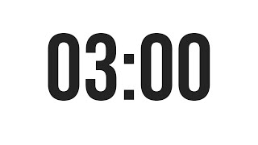
Clarifying Questions ...
Problem Presenter, you decide which questions to respond to
Coaches, these should be CLOSED questions, such as Yes or No - to help provide context

Slide 14
Problem Reframe
Problem Presenter, you confirm if the challenge reframe is accurate
Coaches, one of you quickly reframes the challenge you have heard shared

Slide 15
Powerful Questions
Coaches, ask succinct, direct, powerful questions.
Problem Presenter, you do NOT respond to these questions, receive them

Slide 16
Problem Presenter Reflection(s)
Problem Presenter, if you want to share how the PROCESS felt, please do so now
Coaches, listen, affirm with snaps,no interruptions

Slide 17
Commitments, Reflections & Resources
Each Problem Presenter will share their takeaways, reflections and commitments
(2 min)
Table group asks How can we support you? What resources might you need?
Coaches offer support and resources as they can.
Resist from sharing advice!
Notes:
4:25-4:35 Commitments
4:35 – 4:40 Close out

Slide 18
Gratitude
Each person at your table shares one thing you are taking away from Action Learning approach
and one thing you are grateful for today.
Notes:
4:25-4:35 Commitments
4:35 – 4:40 Close out

Slide 19
About WPTI
WPTI increases the effectiveness of people, programs, and organizations that are generating pathways out of poverty through employment. Our three-tiered approach strengthens capacity at all levels of the workforce development system.
Professional Training: Develop the skills and careers of practitioners
Organizational Consulting: Maximize productivity of programs and teams
Systems Building: Create linkages, foster research and influence funding and best practice priorities
Practitioner &
Organizational
Development
For questions, please contact:
Sherazade Langlade Sabeen Pirani
slanglade@workforceprofessionals.org spirani@workforceprofessionals.org
Check WPTI's upcoming workshops at : www.workforceprofessionals.org/our-work/program-calendar or scan QR code to the left
linkedin.com/company/wpti

Slide 20
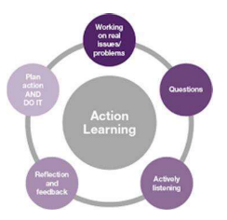
Action Learning
Action Learning is a process that involves a small group working on real problems, taking action, and learning as individuals, as a team, and as an organization.
It helps individuals develop creative, flexible and successful strategies to pressing problems through the use of insightful questioning and reflective listening.
Action Learning tackles problems through a process of
Asking questions to clarify the exact nature of the problem,
reflecting and identifying possible solutions,
Committing to action.
Questions build group dialogue and cohesiveness, generate innovative and systems thinking, and enhance learning results.

Slide 21
What is Action Learning
Gets to the heart of the matter using deep listening and powerful questions
Sparks new / differing perspectives on issues
Engages group in peer-based inquiry and coaching
Explores and clarifies over giving advice and solving problems for others.
Supports each person to identify meaningful and viable solutions.

