Slide 1
Defining Your Leadership Legacy
William Collins

Slide 2
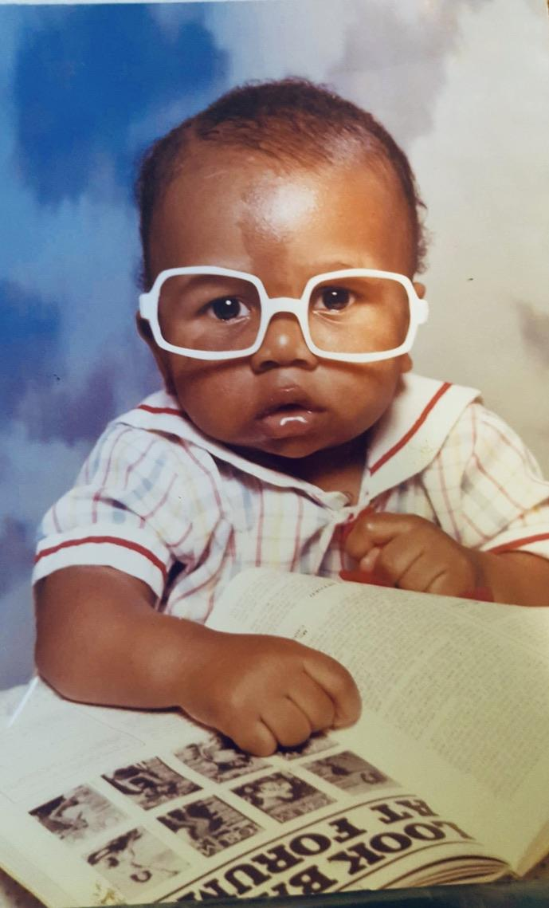

Slide 3
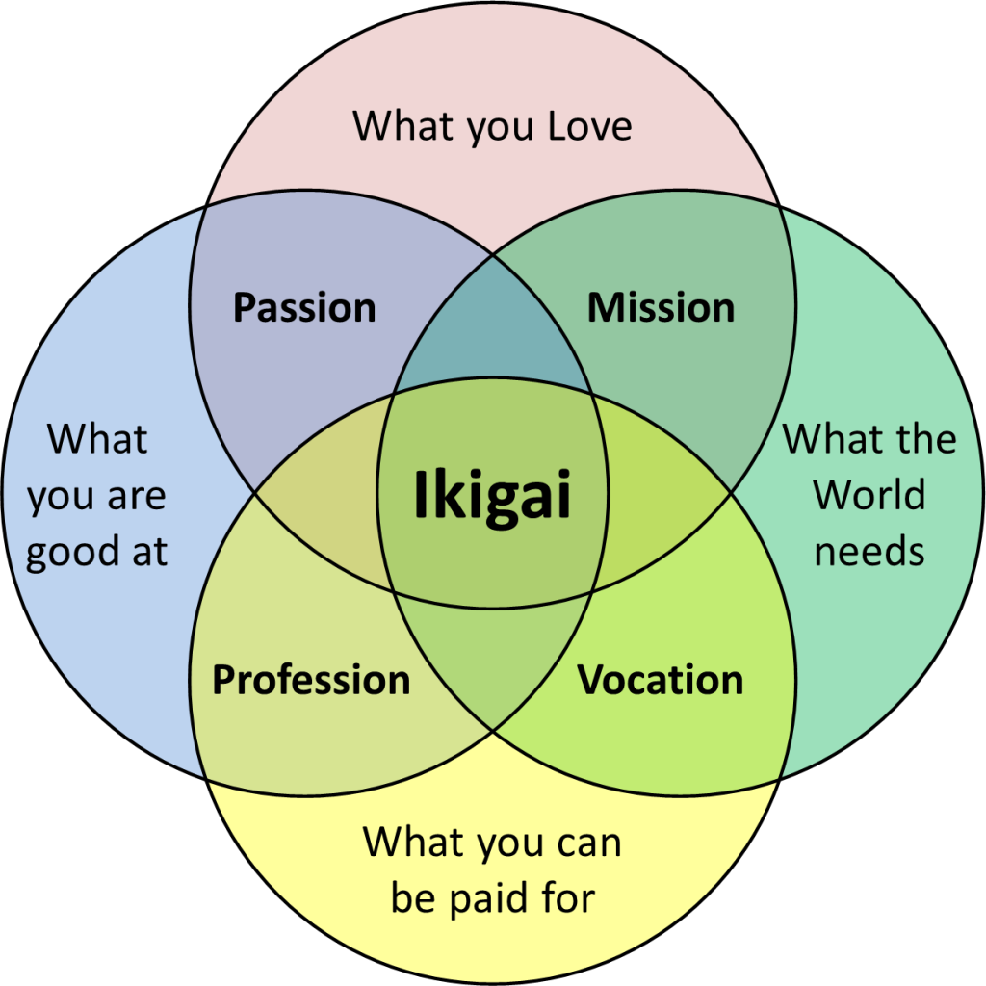

Slide 9
