Slide 1

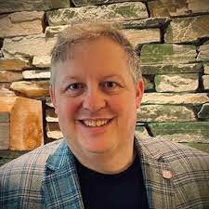
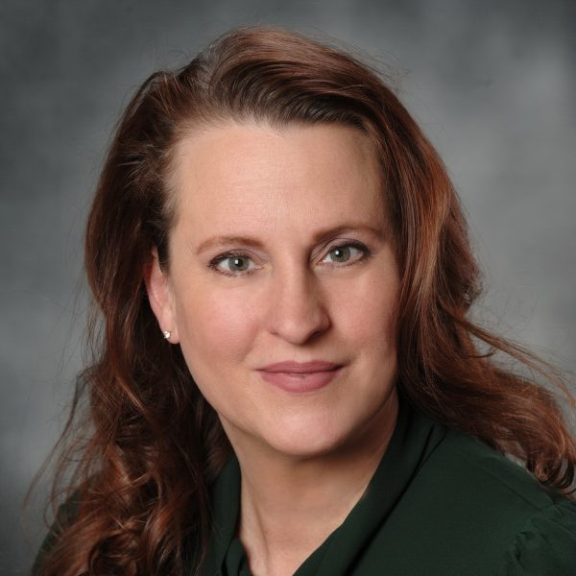
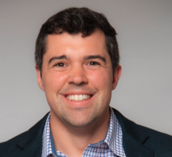
Charting Success as a Faculty Member: Roles, Tenure, Salary, and the Start-up Package
James E. Bartlett, II, Ph.D.
Michelle E. Bartlett, Ph.D.
Gresham Collom, Ph.D.
Old Dominion University
Old Dominion University
University of Minnesota

Slide 2

Objectives
Roles and Responsibilities
Salary & Start-up Package
Obtaining faculty positions
Tenure & Faculty Success

Slide 3



Finding the Job
Ph.D.
How to find them
  Professional Conferences
  Chronicle of Higher Education
  Higheredjobs.com
  Networking
Process
  CV, Cover Letter, References
  Phone Interview
  On-campus interview
    Job Talk
    Teaching
  After the process
Research & Teaching
Postdoctoral Experiences

Slide 4



Roles
Time Management
Teaching
  Curriculum Development
  Student Engagement
  Mentoring
Research
  Funding
  Publications
  Presentations
Service
  Local
  Community
  Professional
Priorities
Work-Life Balance

Slide 5

Factors Influencing Selection
APPLY EVEN IF YOU DO NOT HAVE EVERYTHING THE ANNOUCEMENT ASKS FOR
Research Experience
Grants
Publications
Presentations
Leveraging Postdoctoral Experience
Teaching
Networking and Collaborators
Building professional relationships

Slide 6


Negotiating Salary and Start-up Packages
Understand market rates
Look up benchmarks
Negotiation of other items
  Teaching load
  Summer pay
  Stipends
Start-up Packages
  Equipment
  Travel
  GA
  Software
  Furniture
This Photo by Unknown Author is licensed under CC BY-SA-NC

Slide 7
How Does Tenure-Track Work
Why Tenure
Key Tenure Milestones
  Annual Review
  3rd Year Review
Department
  Culture
  Expectations
  Mentor
Strategies for Success
  Strong portfolio and pipeline
  Effective teaching evaluations
  Service contributions
  Collegiality
TENURE AND THE PROCESS

Slide 8

Career Progression and Professional Growth
Continuously Develop
and
Learn
Career Milestones
  Associate / Full / Administration
Leadership Roles
  Institution
  Profession
Long-term Professional Development
  Continuing Education
  Sabbaticals
  Professional Organizations
  Books, Grants…..
  Setting your own goals
This Photo by Unknown Author is licensed under CC BY-NC

Slide 9

Job Satisfaction and Work-Life
Can
You
Balance?
What is Job Satisfaction
  Personal Goals
  Professional Values
  Strategies to avoid burn-out
  Alignment of Organization and Person
Work-Life
  Academic Responsibilities and personal life
  Support systems
  Self-care
This Photo by Unknown Author is licensed under CC BY

Slide 10

Academic Career Challenges
Rejection and Critical Feedback
Setbacks
  Reject articles
  Rejected grants
  Rejected new course ideas
  Not getting an administrative position
  Budget cuts
Adaptivity and Resilience
  Coping with academic pressure (reviews)
  Develop new research
  Develop new courses
  Find new organizations and outlets
This Photo by Unknown Author is licensed under CC BY-SA-NC

Slide 11

Conclusions
Conduct a gap analysis
  Identify areas to develop
  Find a mentor
Start looking early
  Look broader
  Identify types of schools
  Practice jobs talks
  Have CV reviewed
Develop your strategies for success

Slide 12
QUESTIONS
Dr. James Bartlett, II, Ph.D. Associate, Old Dominion University Jbartlet@odu.edu
Dr. Michelle Bartlett, Ph.D. Assistant Professor, Old Dominion University
Mbartlet@odu.edu

