Slide 1
Postsecondary Higher Education Policy in an Election Year
CTE Leadership Collaborative Convening
September 24, 2024
LSCME Webinar

Slide 2
Our Mission
OCCRL researchers study policies, programs, and practices designed to enhance outcomes for diverse youth and adults who seek to transition to and through college to employment.
Strengthening Pathways for All Students Through Research and Leadership
www.occrl.Illinois.edu
an initiative of

Slide 3
The College Completion Era (2009-Current)
I ask every American to commit to at least one year or more of higher education or career training. This can be community college or a four-year school; vocational training or an apprenticeship. But whatever the training may be, every American will need to get more than a high school diploma…That is why we will provide the support necessary for you to complete college and meet a new goal: by 2020, America will once again have the highest proportion of college graduates in the world.
President Obama
2009 Address to Joint Session of Congress
www.occrl.Illinois.edu
an initiative of

Slide 4
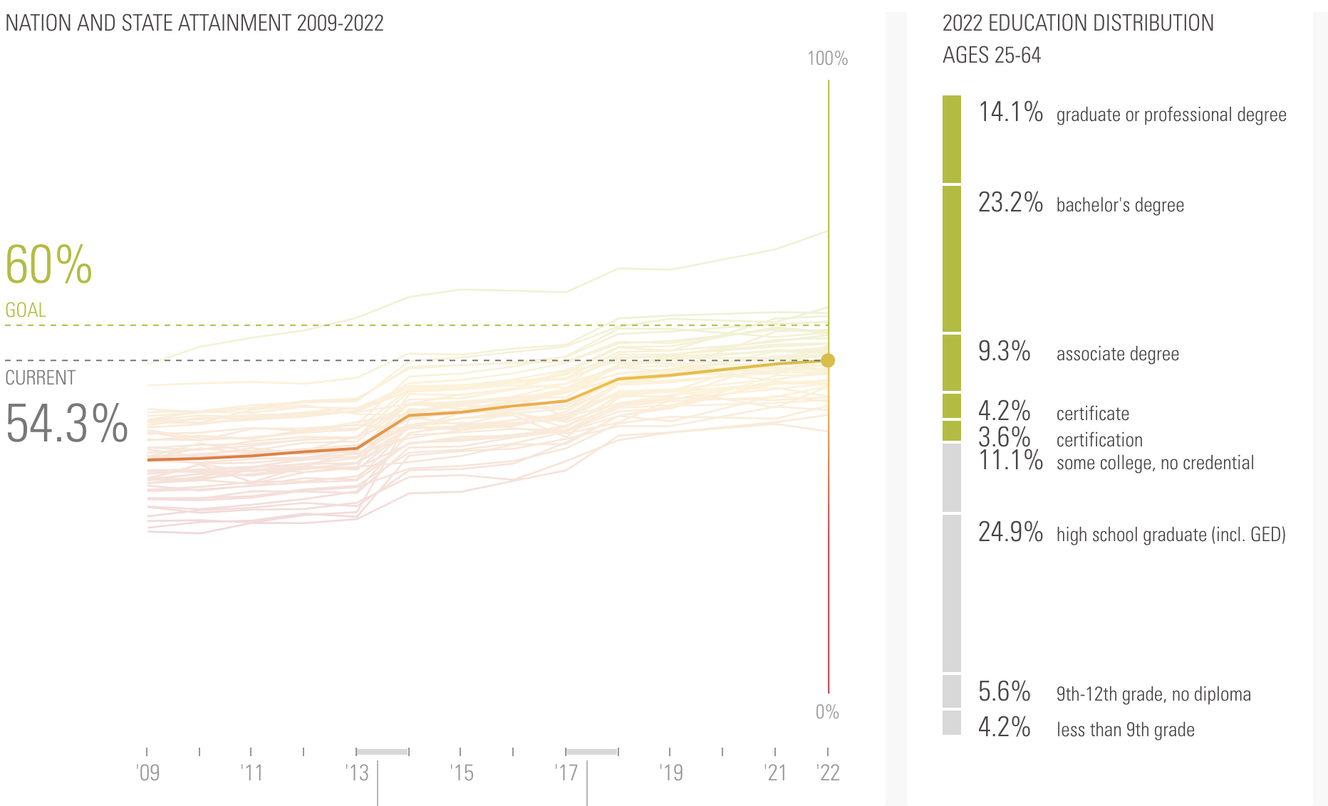
Postsecondary Attainment Rates
Lumina Foundation, A Stronger Nation (2023)
www.occrl.Illinois.edu
an initiative of

Slide 5
Past as Prologue: Sociopolitical Shaping of
Higher Education
Higher Education to craft community leadership
local charters to train clergy
State-chartered universities for local development of future secular leaders
Teaching institutions to support elementary and secondary education systems
Higher Education to advance scientific knowledge and technical training
Morrill Act of 1862, 1890
Discipline emphasis (e.g. liberal arts, sciences, humanities, engineering, business, medicine)
Smith-Lever Act, 1914 establishes Cooperative Extension Offices
.
www.occrl.Illinois.edu
an initiative of

Slide 6
Past as Prologue: Sociopolitical Shaping of
Higher Education
Broadening Participation across all Demographics
Serviceman’s Readjustment Act of 1944 (e.g., G.I. Bill)
Vocational Education Acts, 1946 & 1984
National Defense Education Act, 1958
Title IX, 1972
Higher Education Acts, 1965-2008*
Shifting Costs for Higher Education (Public to Private)
Middle Income Student Assistance Act, 1978
Parent Plus Loan Program Introduced, 1980
Elimination of Cap on Parent Plus Loan Programs, 1992
Declining State Appropriations for higher education via recession cycles (1975, 1982, 2009)
.
www.occrl.Illinois.edu
an initiative of

Slide 7
Past as Prologue: Sociopolitical Shaping of
Higher Education
Shifting Costs for Higher Education (Public to Private)
Middle Income Student Assistance Act, 1978
Parent Plus Loan Program Introduced, 1980
Elimination of Cap on Parent Plus Loan Programs, 1992
Declining State Appropriations for higher education via recession cycles (1975, 1982, 2009)
.
www.occrl.Illinois.edu
an initiative of

Slide 8
Consistent Tensions within Higher Education
What is the purpose of Higher Education?
Who should have access to postsecondary pathways?
Is a postsecondary credential primarily a private good or a public good?
What defines a high-quality postsecondary education classroom/institution/system?
.
www.occrl.Illinois.edu
an initiative of

Slide 9
Key Issues in Higher Education, 2024 Cycle
College Affordability
Federal Role in Higher Education
Interpretation of Title IX
Diversity, Equity and Inclusion policies and practice
Defining Free Speech/Civility/Democracy on Campus
.
www.occrl.Illinois.edu
an initiative of

Slide 10
Key Issues in Higher Education, 2024
Alternative Pathways to Career Sustainability and Success (Bipartisan Agreement)
Nondegree training programs
Emphasis on skill and workforce experience over degree credentials within minimum qualifications for hiring
Competency-based education models for training and credit attainment
Emphasizing Pathways through Workforce Development or Community Colleges
.
www.occrl.Illinois.edu
an initiative of

Slide 11
Stay Informed!
Subscribe to the OCCRL Network News and receive updates on all of OCCRL’s research, professional development, and other events.
go.education.illinois.edu/occrlsubscribe
www.occrl.Illinois.edu
an initiative of

