Slide 1
How Postsecondary CTE is Impacting Priority Communities
Dr. Lorenzo Baber
Dr. Gianina Baker
www.occrl.Illinois.edu
an initiative of

Slide 2
Our Mission
OCCRL researchers study policies, programs, and practices designed to enhance outcomes for diverse youth and adults who seek to transition to and through college to employment.
Strengthening Pathways for All Students Through Research and Leadership
www.occrl.Illinois.edu
an initiative of

Slide 3
U.S. Postsecondary Completion Rates – Credential or higher (Lumina, 2023)
www.occrl.Illinois.edu
an initiative of

Slide 4
Postsecondary Completion Rates: Illinois Example
Educational attainment among working-age adults in Illinois is 56.9 percent which exceeds the national average of 53.7 percent, but falls below the goal of 60 percent by 2025
Much of the above-national average attainment rate in Illinois is carried by four counties – DuPage (61.2%), McLean (56.7%), Champaign (56.6%), and Lake (54.3%). The remaining counties including the largest, Cook County, have attainment rates below the state and national average.
There are seven counties in Illinois with more than 100k working adults and less than 50% postsecondary attainment rates – McHenry (47.8%), Will (46.6%), Kane (45%), Sangamon (44.6%), St. Clair (42.6%), Madison (42.3%), and Winnebago (33.9%).
Illinois continues to fall short in addressing racialized inequalities within attainment rates – including a 33.9% attainment rate among the 900k Black working adults and a 25.3% attainment among the 1.13 million Latinx population.
10.7% of working adults in Illinois have some college, but no credential (more than those with an associate’s – 8.7%).
Lumina Foundation, A Stronger Nation (2023)
www.occrl.Illinois.edu
an initiative of

Slide 5
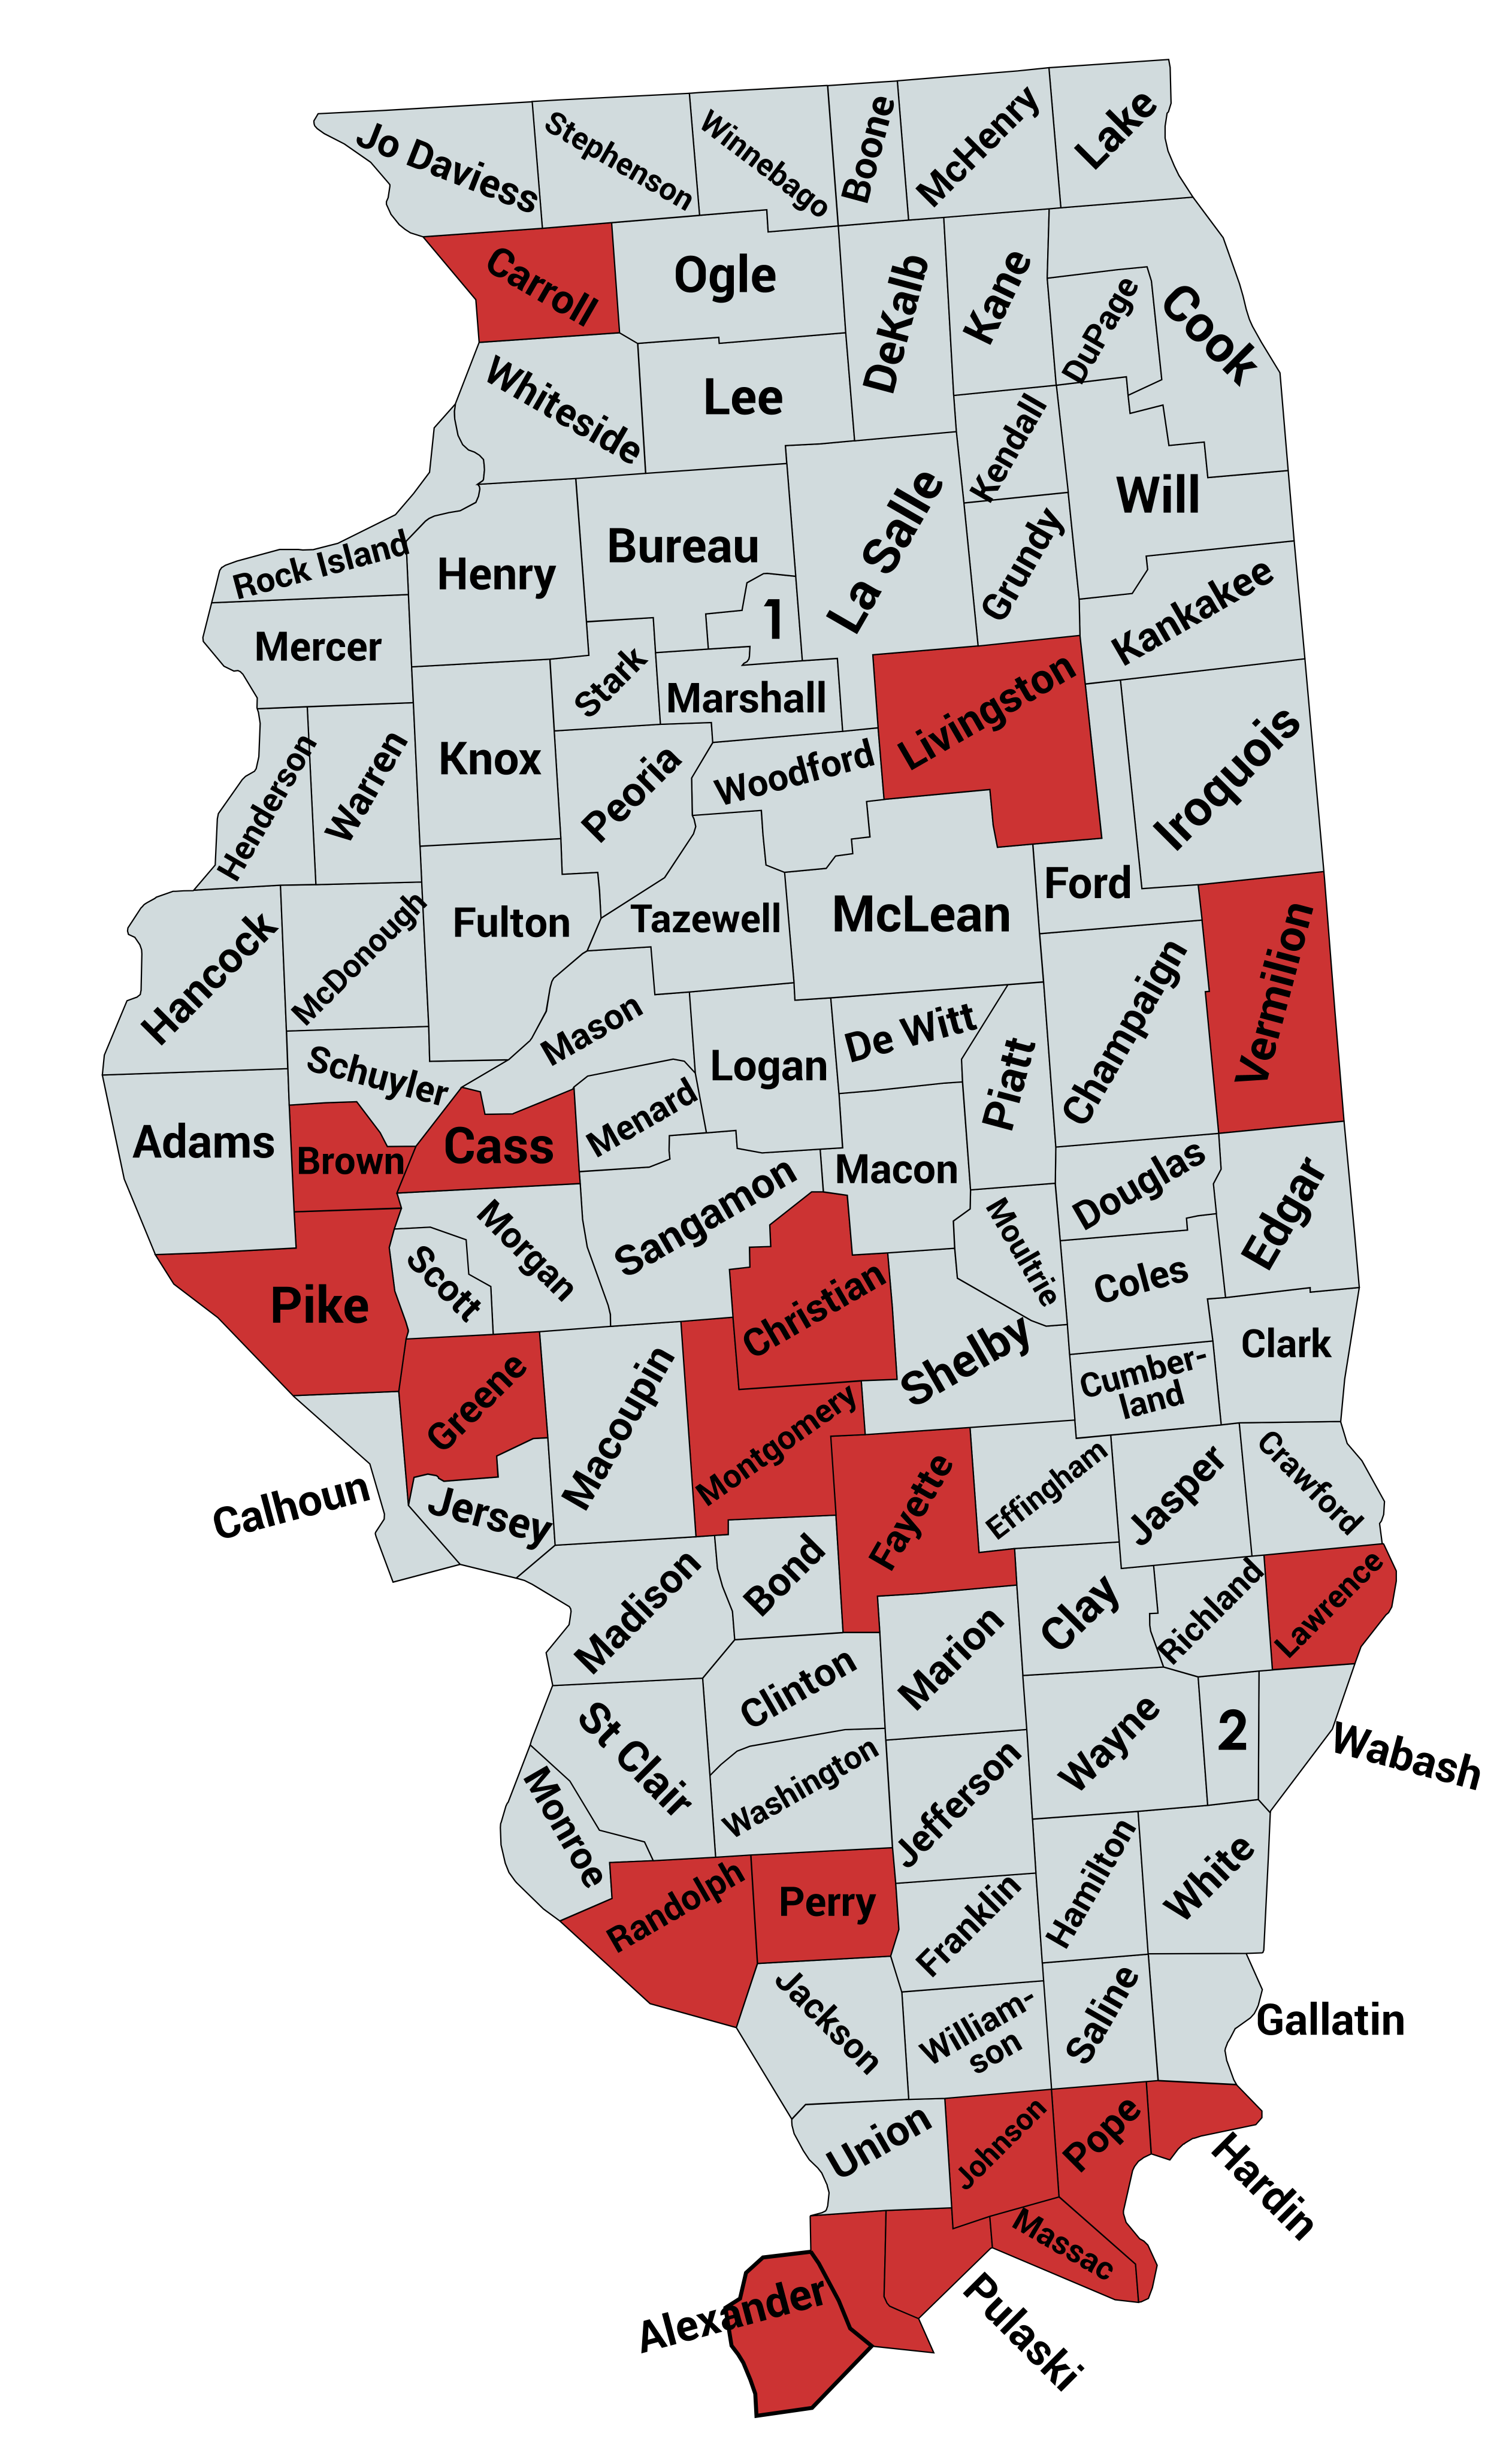
Illinois Counties with Lowest Postsecondary Attainment
Alexander 17.1%
Brown 22.3%
Pulaski 23.9%
Randolph 24.2%
Gallatin 25.0%
Greene 25.3%
Perry 25.4%
Pope 26.1%
Johnson 26.7%
Massac 26.9%
Lawrence 27.3%
Montgomery 27.5%
Cass 27.7%
Vermillion 28.5%
Hardin 28.5%
Carroll 28.9%
Pike 28.8%
Christian 29.5%
Livingston 29.6%
Fayette 29.6%
.
www.occrl.Illinois.edu
an initiative of

Slide 6
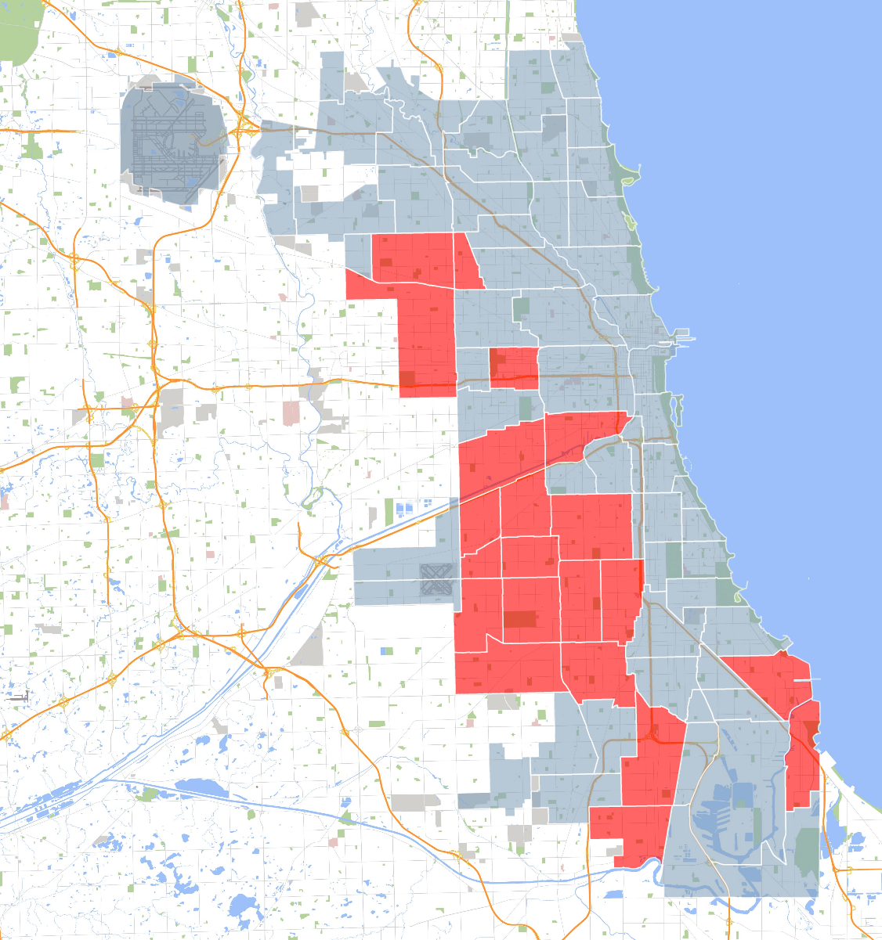
Chicago Neighborhoods with Lowest Postsecondary Attainment
New City 8.3%
Gage Park 10.5%
South Lawndale 11.0%
Chicago Lawn 11.9%
W. Englewood 12.1%
Brighton Park 13.3%
Chicago Lawn 14.2%
Englewood 14.9%
Archer Heights 15.1%
Hermosa 15.5%
West Elson 16.3%
South Austin 16.9%
E Garfield 17.1%
East Side 17.2%
West Lawn 17.4%
Cragin 18.7%
West Austin 19.7%
Auburn 21.6%
West Pullman 21.9%
Belmont 22.4%
S. Chicago 23.3%
Roseland 24.9%
Lower W. Side 27.8%
.
www.occrl.Illinois.edu
an initiative of

Slide 7
Illinois Counties with >20,000 households; <40% postsecondary attainment rate; >40% Below Poverty Line (BPL) + Asset-Limited, Income-Constrained, Employed (ALICE)
County | Households | Attainment | BPL + ALICE
Winnebago | 115,282 | 33.9% | 41.4%
Rock Island | 60,187 | 35.7% | 41.7%
Macon | 43,914 | 34.1% | 43.3%
Kankakee | 41,020 | 32.6% | 40.1%
Vermillion | 29,007 | 28.5% | 47.5%
Williamson | 27.361 | 39.6% | 41.0%
Knox | 20,575 | 33.9% | 49.3%
Coles | 20,269 | 39.2% | 46.2%
Cook | 2,072,143 | 50.4% | 36.2%
Alexander | 1,781 | 17.3% | 66.3%
.
www.occrl.Illinois.edu
an initiative of

Slide 8
Perkins V Data
Special Populations:
Individuals with disabilities
Individuals from economically disadvantaged families, including low-income you and adults
Individuals preparing for non-traditional fields
Single parents, including single pregnant women
Out-of-workforce individuals
English learners
Homeless individuals
Youth who are in, or have aged out of, the foster care system
Youth with a parent who: is a member of the armed forces and is on active duty
Migrant students (secondary only)
www.occrl.Illinois.edu
an initiative of

Slide 9
Comprehensive Local Needs Assessment (CLNA)
The Perkins V comprehensive local-needs assessment (CLNA) moves beyond checklist types of assessment processes and instead aims to facilitate a data-informed, continuous improvement process for community colleges to biannually assess the extent to which their career and technical education (CTE) programs and programs of study are aligned with local workforce and economic needs. Using an equity lens, the CLNA requires disaggregation of data to highlight, analyze, and work toward closing equity gaps for underserved populations. The CLNA process also crosswalks Perkins V and the Workforce Innovation and Opportunity Act (WIOA) requirements for standards and examination of equity and access for specific student subpopulations (Perkins V). Community colleges are required under Perkins V to engage a diverse body of stakeholders in the CLNA process. The summation of findings from the Comprehensive Local Needs Assessment process are to inform school districts’ and community colleges’ development of their Perkins V local application for funding.
Sections include:
Progress Toward Equity and Access
Student Performance
Recruitment, Retention, and Training of CTE Educators
Stakeholder Participation and Voice
Labor Market Alignment
Program Size, Scope, and Quality
Progress Toward Implementing Programs of Study
Plan of Action: Preparing your Local Application
www.occrl.Illinois.edu
an initiative of

Slide 10
Discussion Questions
What do you see as the current state of postsecondary CTE programs?
Changing workforce demands?
Seeing an increasing emphasis on postsecondary credentials for entry-level positions?
How is your institution creating an inclusive workforce that meets the needs of a rapidly changing economy while empowering marginalized communities?
Are your programs providing equitable opportunities for individuals from underrepresented backgrounds?
Challenges
Opportunities
Who are your priority communities?
Are you currently collecting data on said community(ies)?
How would you use the data to address disparities in access to education to high-wage, high-demand jobs for those in under-resourced communities?
What role can industry partners play in supporting the need for an inclusive workforce?
What resources do you need to do this work?
.
www.occrl.Illinois.edu
an initiative of

Slide 11
Stay Informed!
Subscribe to the OCCRL Network News and receive updates on all of OCCRL’s research, professional development, and other events.
go.education.illinois.edu/occrlsubscribe
www.occrl.Illinois.edu
an initiative of

